Slide 1

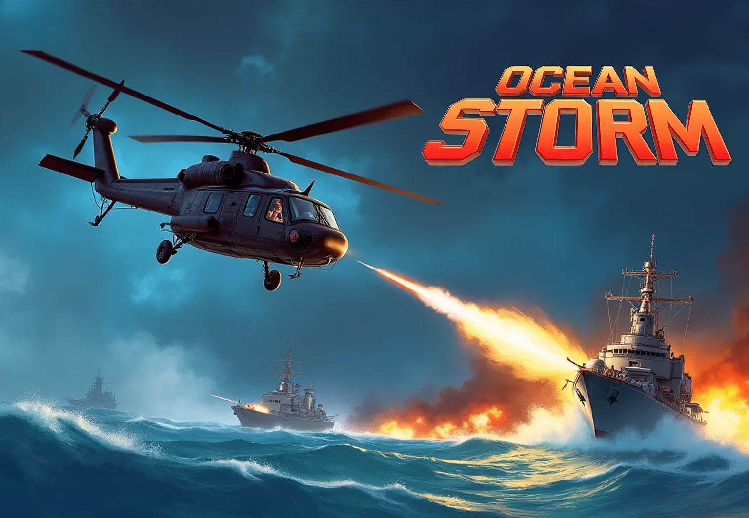


Engage on air and land battles in an effort to stop Black Hand !
PAL / NTSC / OTHER
Multi-region
Cartridge
32-BIT VIRTUAL CONSOLE

